Slide 1

Heart Disease Risk Predictor

Slide 2

Heart Disease Risk Predictor
Darbhanga College of Engineering
Presented by:
Guided by
Prashant Kumar 19105111005
Shefa Rahat Ali 19105111006
Sweety Rai 19105111035
Sumit Prakash 19105111029
Prof. Akhilesh Kumar
Assistant professor, CSE Dept.
Darbhanga College of Engineering.

Slide 3

Contents
Introduction 4
Software Tools & Applications 5-11
Steps for risk prediction 12
Frontend Working and Building 13
Backend Working and Building 14
Dataset and features 15
Website Homepage User Interface 16
Website Patient Details UI 17
Website Patient Result UI 18
References 19
Conclusion 20
Future Scope 21

Slide 4
Introduction
Heart disease is the major cause of morbidity and mortality globally: it accounts for more deaths annually than any other cause.
According to the World Health Organization (WHO), cardiovascular diseases are the number one cause of death globally, accounting for approximately 17.9 million deaths each year.
Heart Disease Risk Level Predictor is a website which detect risk of heart disease build using different algorithms of Machine Learning in backend.
The input to our algorithm is 8 features with number values and binary values. We use algorithms such as Linear Regression and multivariable polynomial regression to output the risk percentage which indicates the chances of having heart disease and it gives us the best accuracy of 76.8%.
And we have created a website by using HTML, CSS and Bootstrap for taking the input of patient details and used the flask module for deploying the machine learning model and processing that data.

Slide 5
SOFTWARE TOOLS & APPLICATIONS
LIBRARIES FRAMEWORK AND COMPONENTS

Slide 6


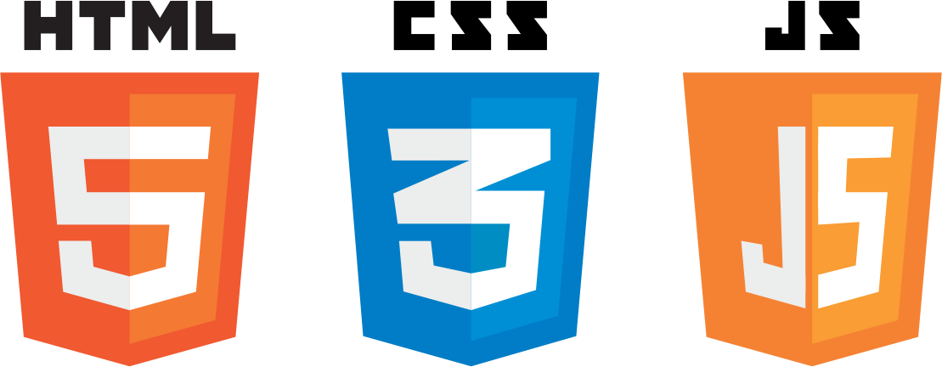

Frontend Software Technologies

Slide 7
HTML (Hyper Text Markup Language)
It is the standard markup language for creating Web pages.
HTML forms the building blocks of all websites.
CSS (Cascading Style Sheet)
Cascading Style Sheets (CSS) is a style sheet language used for describing the presentation of a document written in a markup language such as HTML.
Set of rules defining how an html element will be “presented” in the browser.
JavaScript
Classic JavaScript is a client-side language used to add interactivity your web-pages
JavaScript is used to program the behavior of web pages.

Slide 8
Bootstrap
Bootstrap is a free and open-source CSS framework directed at responsive, mobile-first front-end web development.
It contains CSS- and (optionally) JavaScript-based design templates for typography, forms, buttons, navigation, and other interface components.
GitHub
GitHub, Inc. is a provider of Internet hosting for software development and version control using Git.
It offers the distributed version control and source code management functionality of Git, plus its own features.
Google Chrome
Google chrome is a web browser application software for accessing the World Wide Web or a local website.
When a user requests a web page from a particular website, the web browser retrieves the necessary content from a web server and then displays the page on the user's device

Slide 9





Backend Software Technologies

Slide 10

Visual Studio Code
Visual Studio Code is a source-code editor made by Microsoft for Windows, Linux and macOS.
Features include support for debugging, syntax highlighting, intelligent code completion, snippets, code refactoring, and embedded Git.
Python
Python is an interpreted, object-oriented, high-level programming language with dynamic semantics.
Python supports modules and packages, which encourages program modularity and code reuse.
Jupyter Notebook
The Jupyter Notebook is an open-source web application that can be used to create and share documents that contain live code, equations, visualizations, and text.
Its flexible interface allows users to configure and arrange workflows in data science, scientific computing, computational journalism, and machine learning.
Flask
Flask is a small and lightweight Python web framework that provides useful tools and features that make creating web applications in Python easier.
Flask uses the Jinja template engine to dynamically build HTML pages using familiar Python concepts such as variables, loops, lists, and so on. We have used these templates as part of this project.

Slide 11

Libraries & Module for Algorithm Development
Flask==2.0.3
pandas==1.4.1
joblib==1.1.0
jupyter-client==7.1.2
numpy==1.22.3
sklearn==0.0
scikit-learn==1.0.2
matplotlib-inline==0.1.3
pickleshare==0.7.5

Slide 12
STEPS FOR RISK PREDICTION
HOME PAGE USER INTERFACE
DATA INPUT
DATA PROCESSING USING FLASK
OUTPUT DISPLAYED ON WEBSITE
OUTPUT GENERATED USING ML ALGORITHMS
1
2
3
4
5

Slide 13
Frontend Working and Building
We created a website by using HTML, CSS and Bootstrap for taking the Input from the user and displaying the calculated result.
The website has several pages:-
Home page:
This is the first page of the website which contains the navigation bar and footer along with the (click here) button which will navigate the user to the patient detail page which contains the form.
Patient detail page:
This page contains the form which is required to be filled by the user to calculate the heart risk.
Patient Result page:
This page will display the calculated result along with some reference data which can help the user to compare his/her data with the given normal range.
It contains all the features (gender, age, tc, hdl, sbp, smoke, blood pressure medication, diab) which are required by the machine learning model to predict the result.

Slide 14
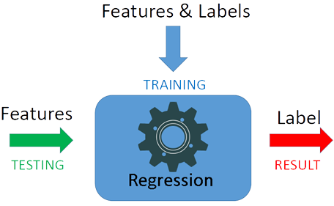
Backend Working and Building
In the backend we have used flask(a framework of python) for deploying the machine learning model and processing that data and used two algorithms-linear regression and multivariable polynomial regression.
The machine learning model was trained using the available data set using the linear regression and multivariable polynomial regression one by one.
Many libraries of python was used/imported for doing this like matplotlib for data visulaization , numpy for performing array operations, pandas, sklearn .

Slide 15
DATASET AND FEATURES
The data set for this model was taken from Kaggle (data repository) and it has 6644 instances.
● gender: gender (1=male; 2=female)
● age: age (in years)
● tc: Total cholesterol (in mg/dL)
● hdl: High-density Lipoprotein (in mg/dL)
● sbp: Systolic Blood Pressure (in mm)
● smoke: smoke (1=yes; 0=no)
● blood pressure medication: Blood Pressure Medication (1=no; 2=yes)
● diab: diabetic type 1(1=yes; 0=no)

Slide 16
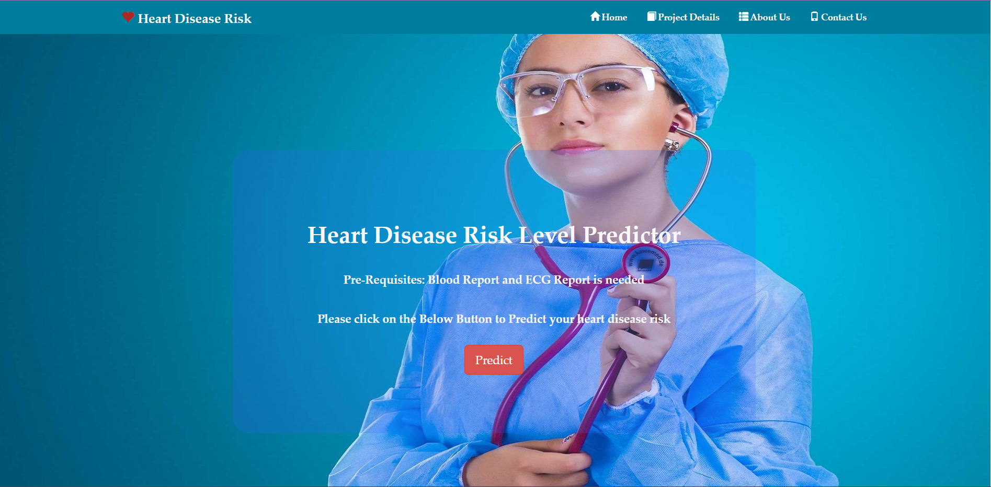
Website Homepage User Interface

Slide 17
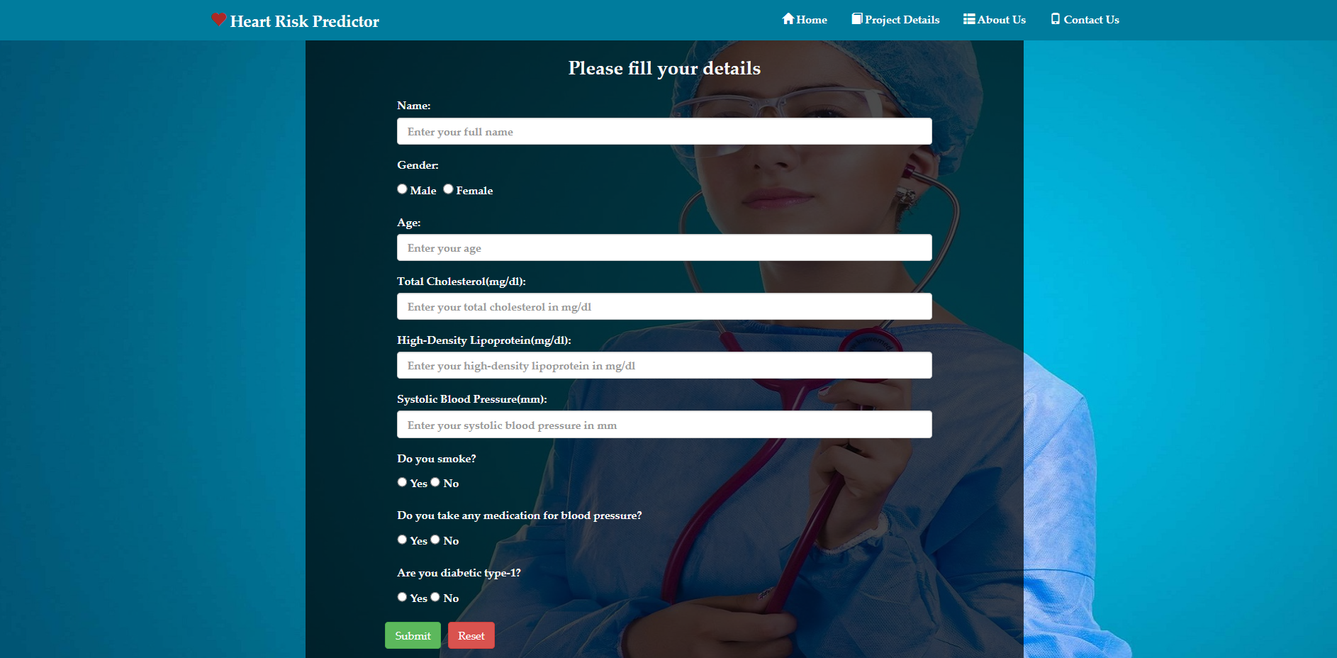
Website Patient Details UI

Slide 18
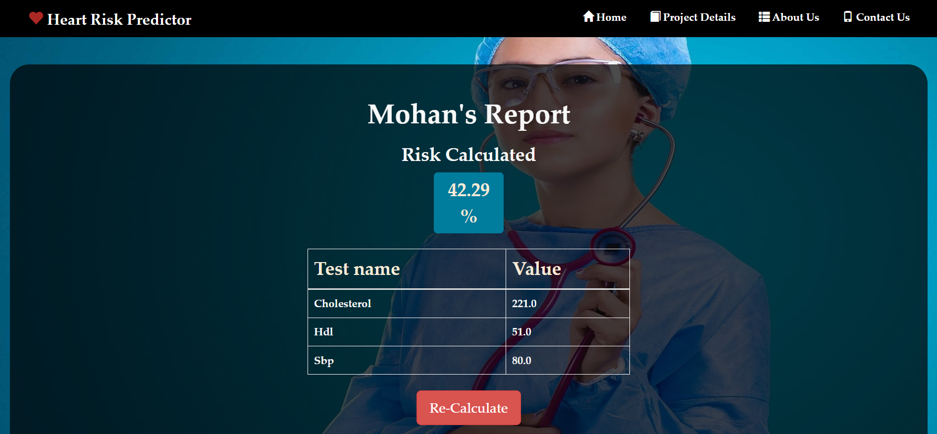
Website Patient Result UI

Slide 19
References
[1] Soni, Jyoti, et al. "Predictive data mining for medical diagnosis: An overview of heart disease prediction." International Journal of Computer Applications 17.8 (2011): 43-48.
[2] Baccouche, Asma, et al. "Ensemble Deep Learning Models for Heart Disease Classification: A Case Study from Mexico." Information 11.4 (2020): 207.
[3] https://archive.ics.uci.edu/ml/datasets/Heart+Disease
[4] https://www.kaggle.com/ronitf/heart-disease-uci

Slide 20
Conclusion
In this project we successfully deployed a website which can be used to predict heart disease risk level by taking patient detail as input.
We used some libraries provided by Python and html, CSS and bootstrap to implement this project. After the experiments, the algorithm of Multivariable Polynomial Regression gives us the best test accuracy, which is 76.8%. The reason why it outperforms others is that it is not limited to the property of the dataset. Regression techniques mostly differ based on the number of independent variables and the type of relationship between the independent and dependent variables.
Though we get a good result of 76.8% accuracy, that is not enough because it cannot guarantee that no wrong diagnosis happens. To improve accuracy, we hope to require more dataset.

Slide 21
Future Scope
The project presently gives the result according to the pre-trained model.
In future the project can be made to update its model and increase the dataset size in order to gain more precision.
And more ways could be found where we can integrate heart-disease-trained ML and DL models with certain multimedia for the ease of patients and doctors for a better and reliable prediction of the cause.

Slide 22
Thank you!

